Slide 1
EDA
Let’s Explore some Data SAT and Drug use in Young Adults

Slide 2
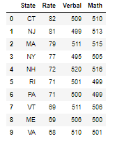

Let’s Start with SAT Data
# We have states and their test metrics:
# Rate (percent of students that take the SAT)
# Verbal (average verbal score)
# Math (average math score)
Check the Difference between Verbal and Math

Slide 3

What do we have?

Slide 4
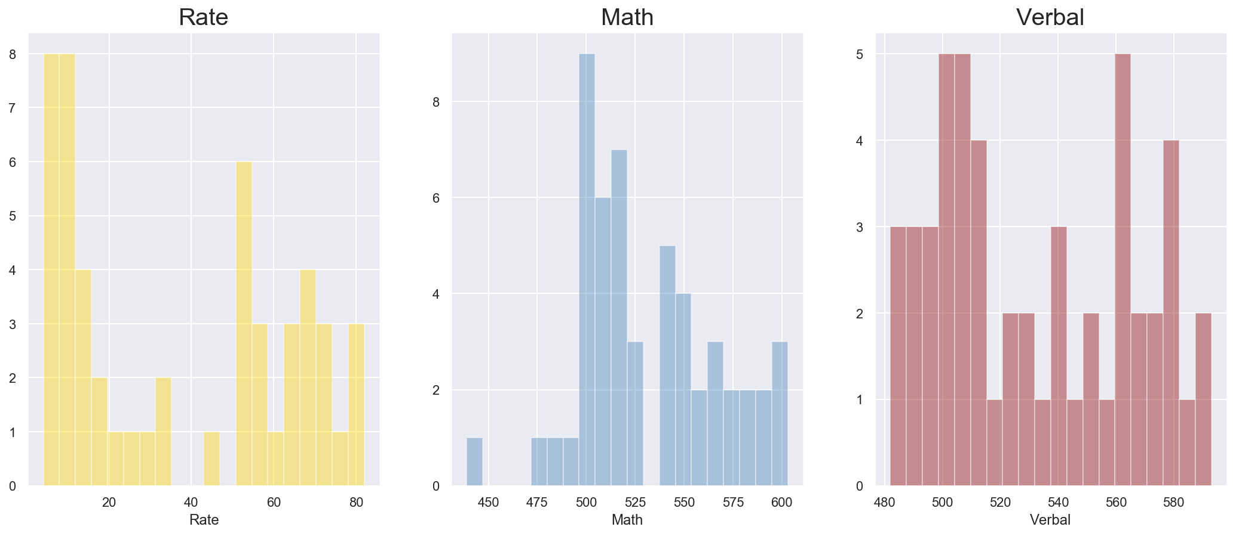
Let’s see some Distribution base on Rate, Math, Verbal

Slide 5
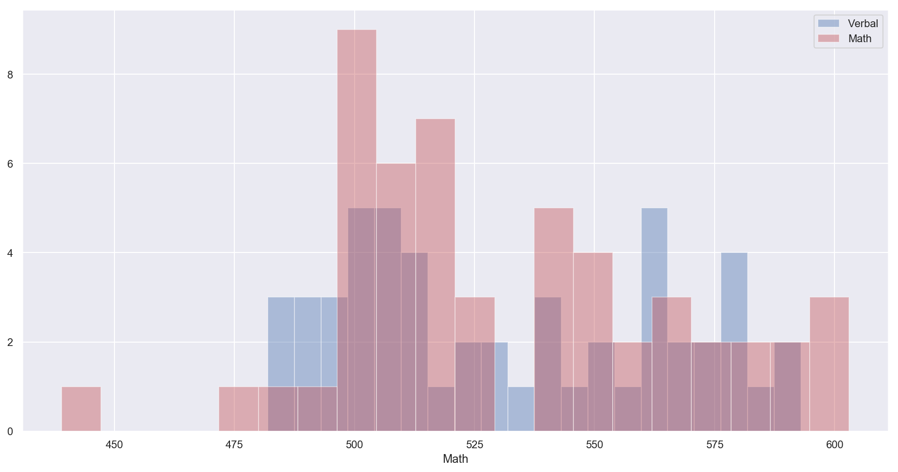
Let’s compare Math and Verbal

Slide 6
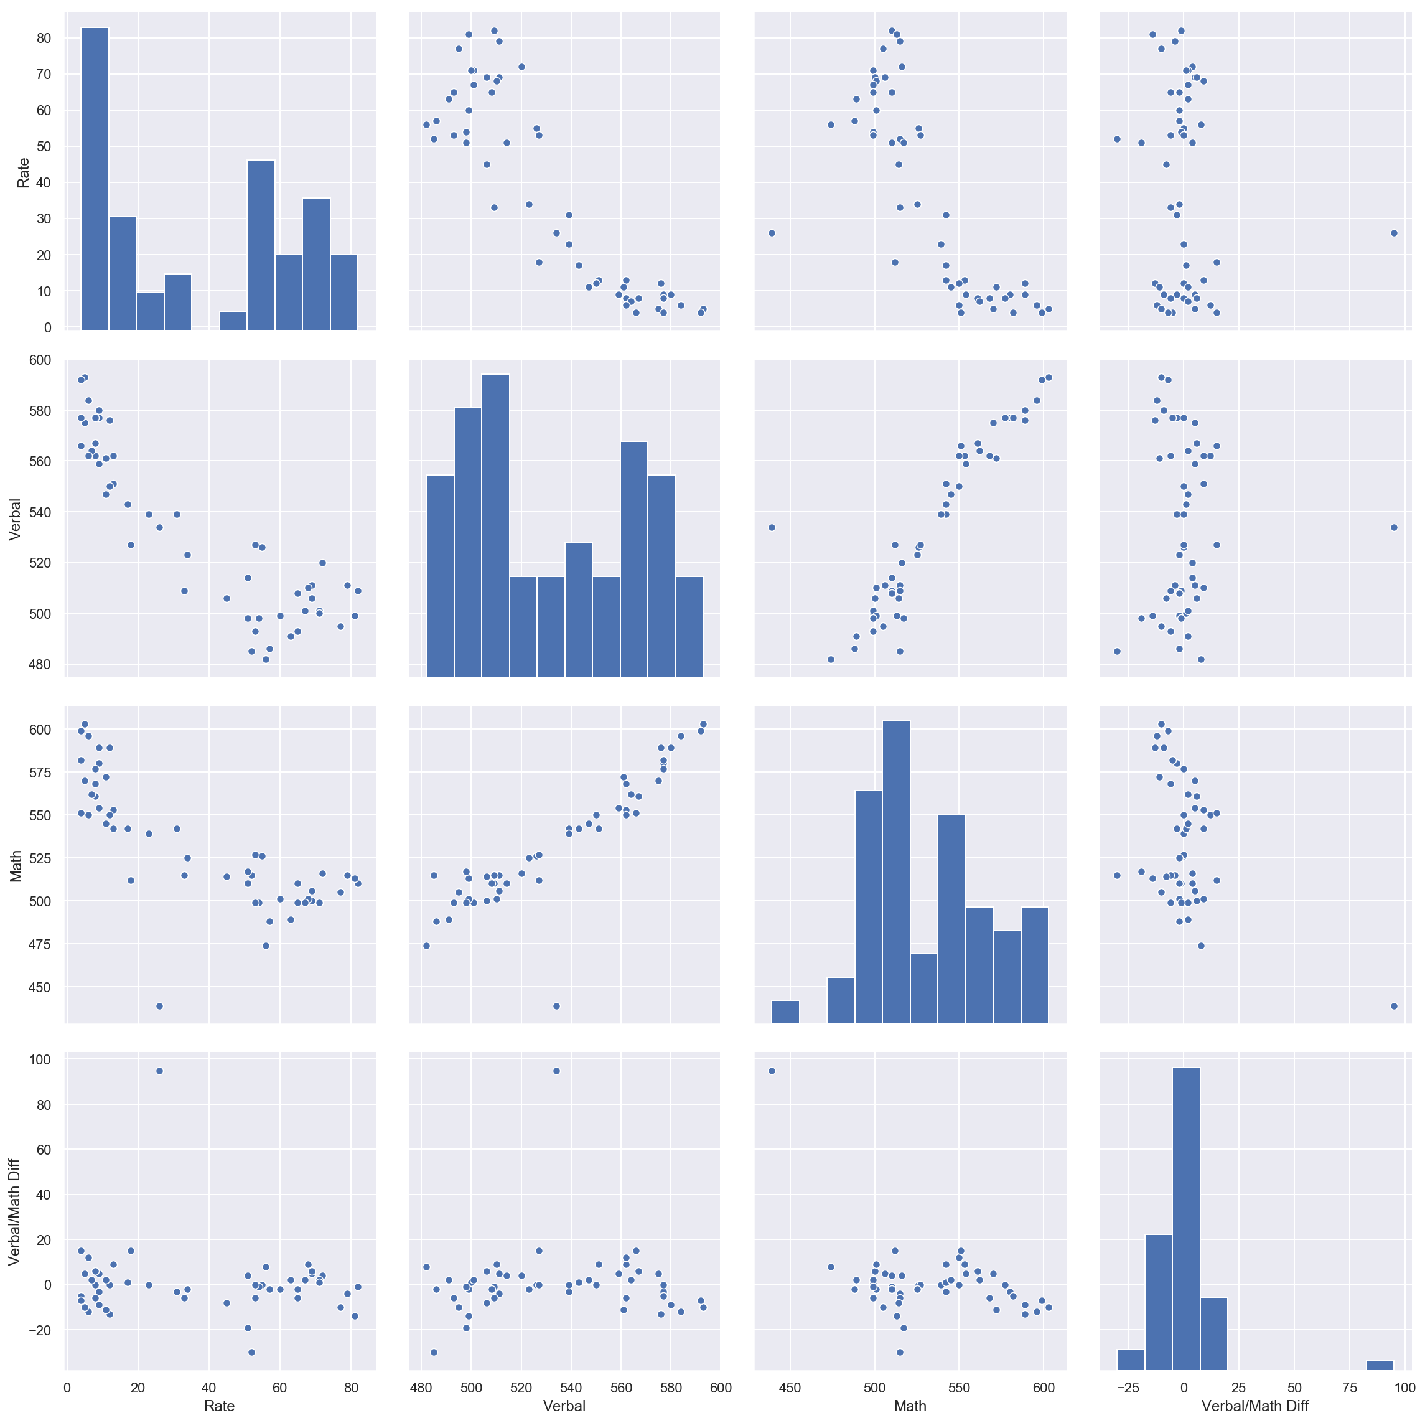
Let’s distribute
Visual Analysis:
Verbal and math are positively correlated.
The "Rate" is negatively correlated to Math and verbal
In a high rate, high math scores and high verbal scores are absent
Here we see both the trend as well as the frequency shown the vertical lines

Slide 7
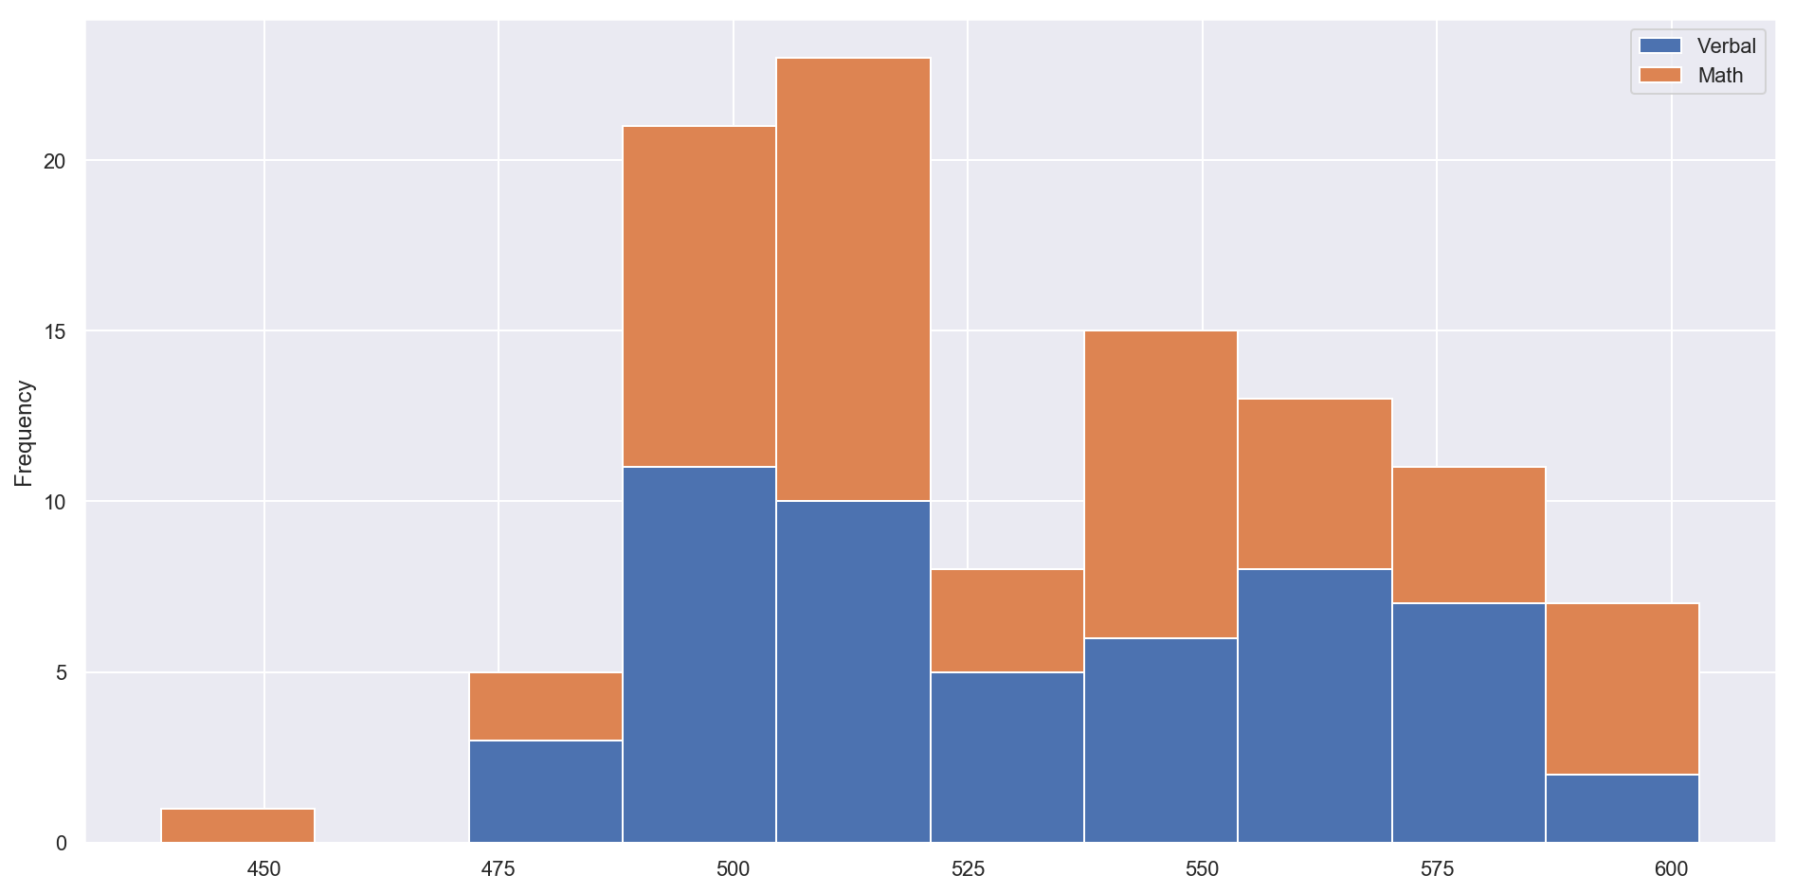
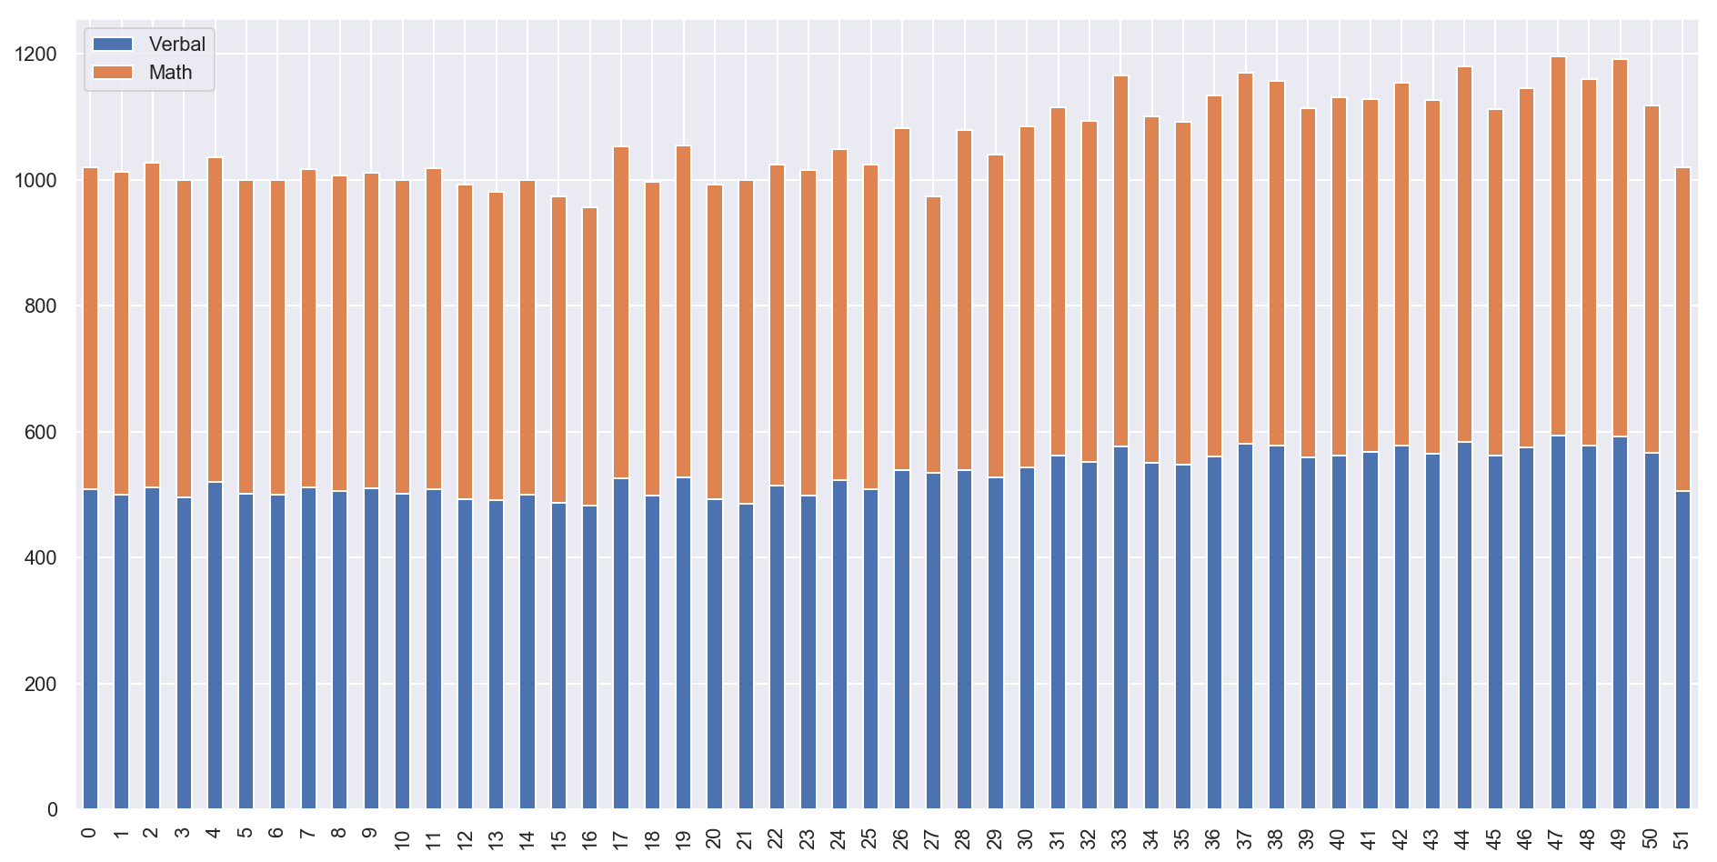
Get stacking

Slide 8
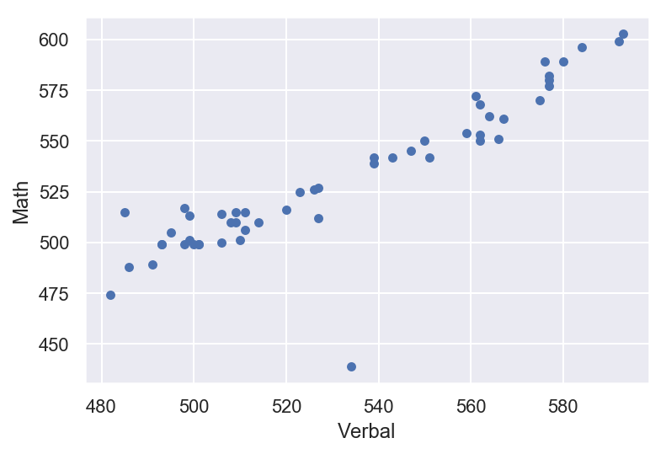
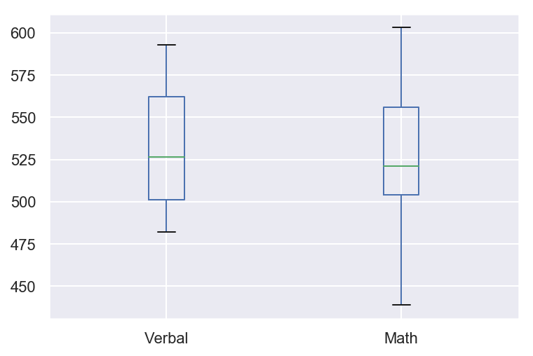
Let’s compare charts
To make sense of the Chart we need to normalize the Variables, as Rate has a large Value hence making Math and Verbal off the Charts. Hence to make the a reasonable comparison we need to make them in a similar scale.
A boxplot provides quantiles and outliers of a variable's distribution Boxplot directly compare side-by-side how these variables are distributed compared to each other, whereas Histogram and Scatter does not show that easily.
A scatterplot will show potential linear relationship between variables, how the variable's observations vary with each other.
Plotting rate on this chart is inappropriate because it is on a different scale as mentioned earlier. Hence the normalization method below are needed to make a comparison.

Slide 9
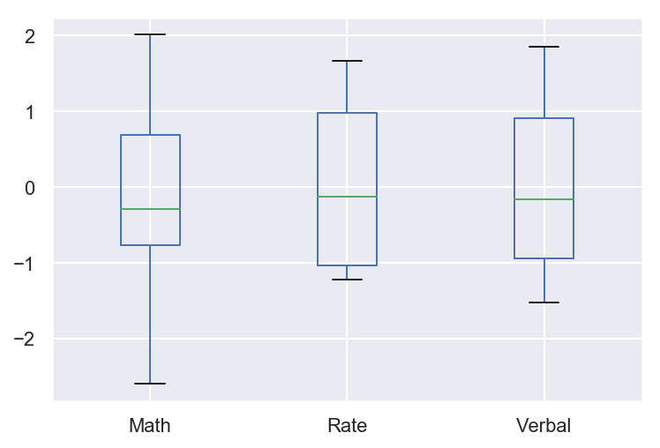
Let’s normalize
Observe Range of Math, Rate and Verbal independently

Slide 10


Dig in to the data
Low Math High Verbal
High Math Low Verbal

Slide 11
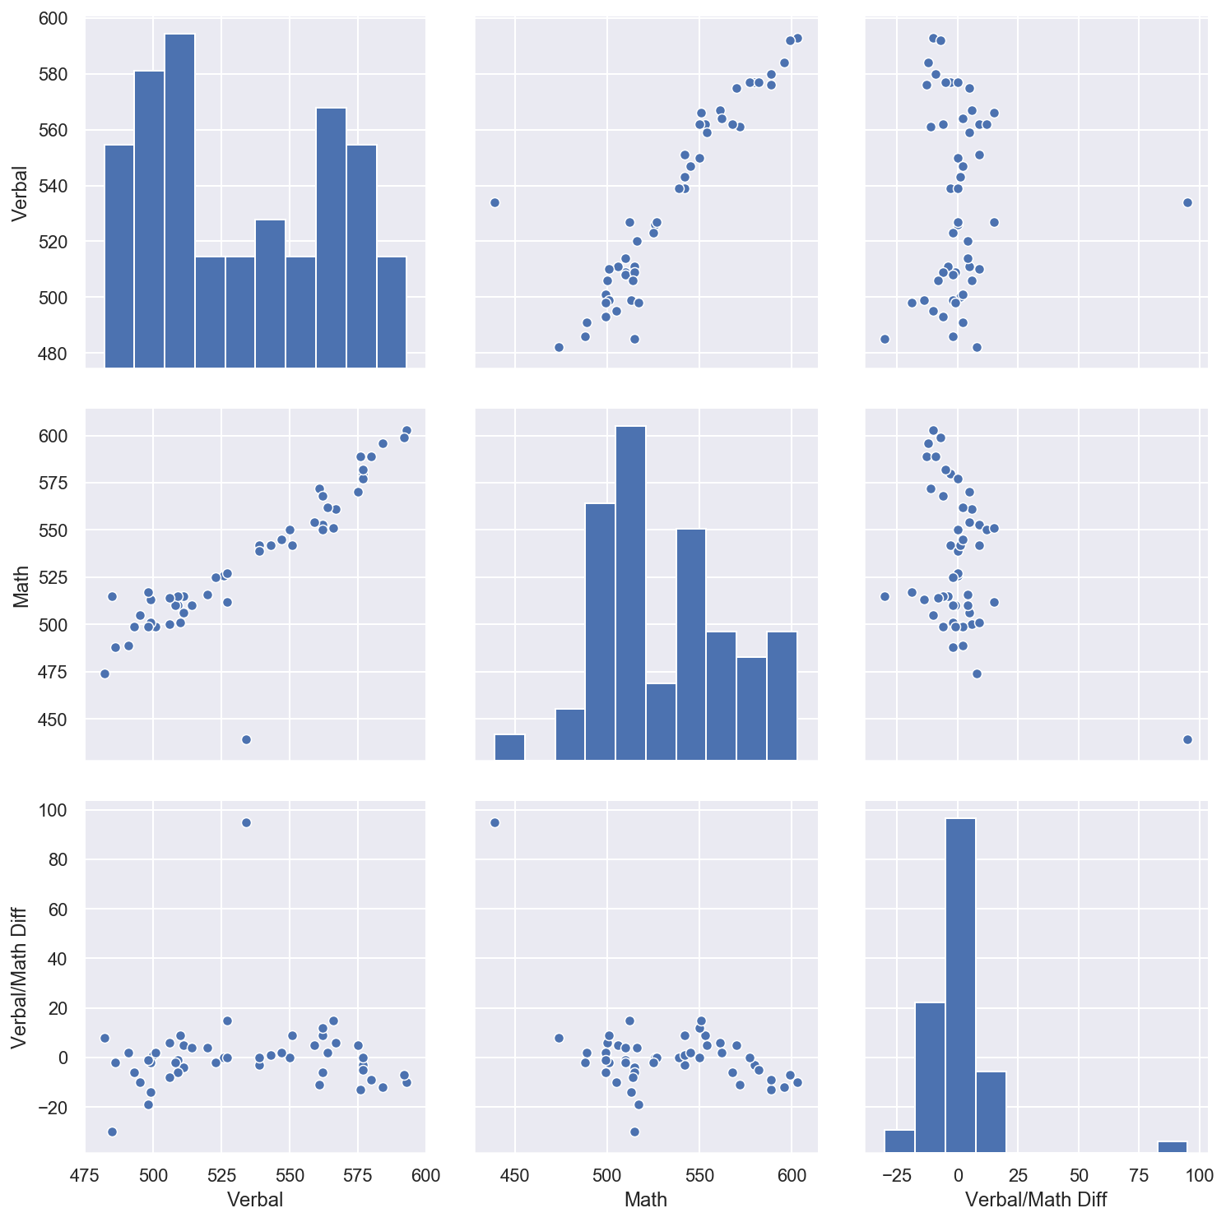
Let’s correlate
When math is good, verbal is good too. when verbal is good, math may not be just as good
A participation rate correlates with a high mathematical score when math is better than verbal when math is worse than verbal,
A high math may not correlate with a high participation rate. From what we can see there's seems to be an outliner that's a little off the chart, hence outliners are easier to identify if it was visualised.

Slide 12
Let’s investigate drug use data sets

Slide 13
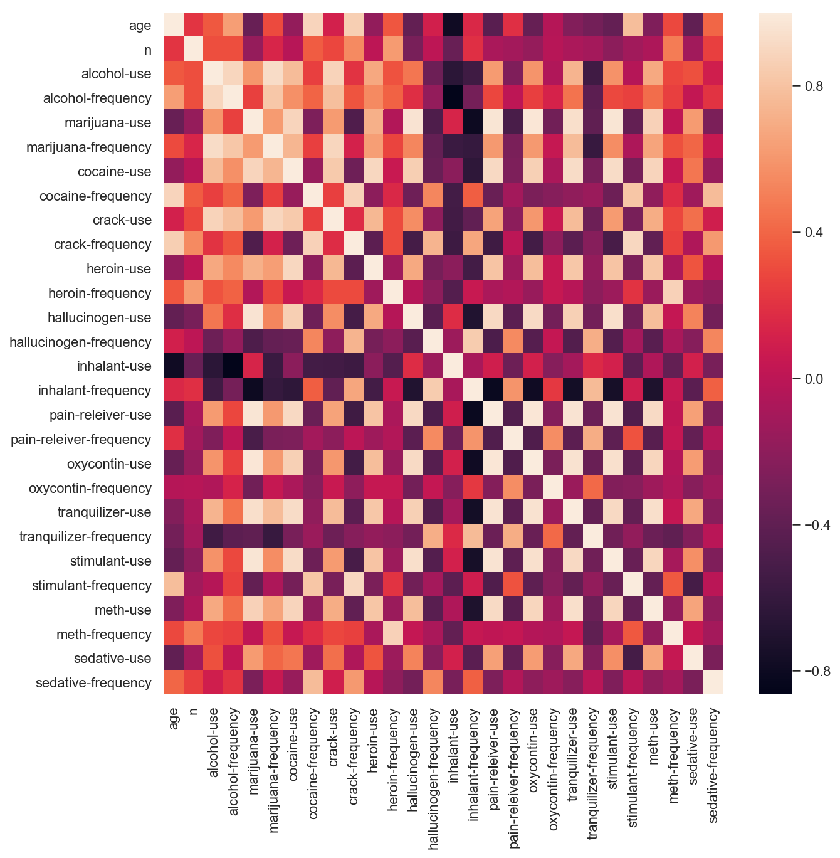

Slide 14
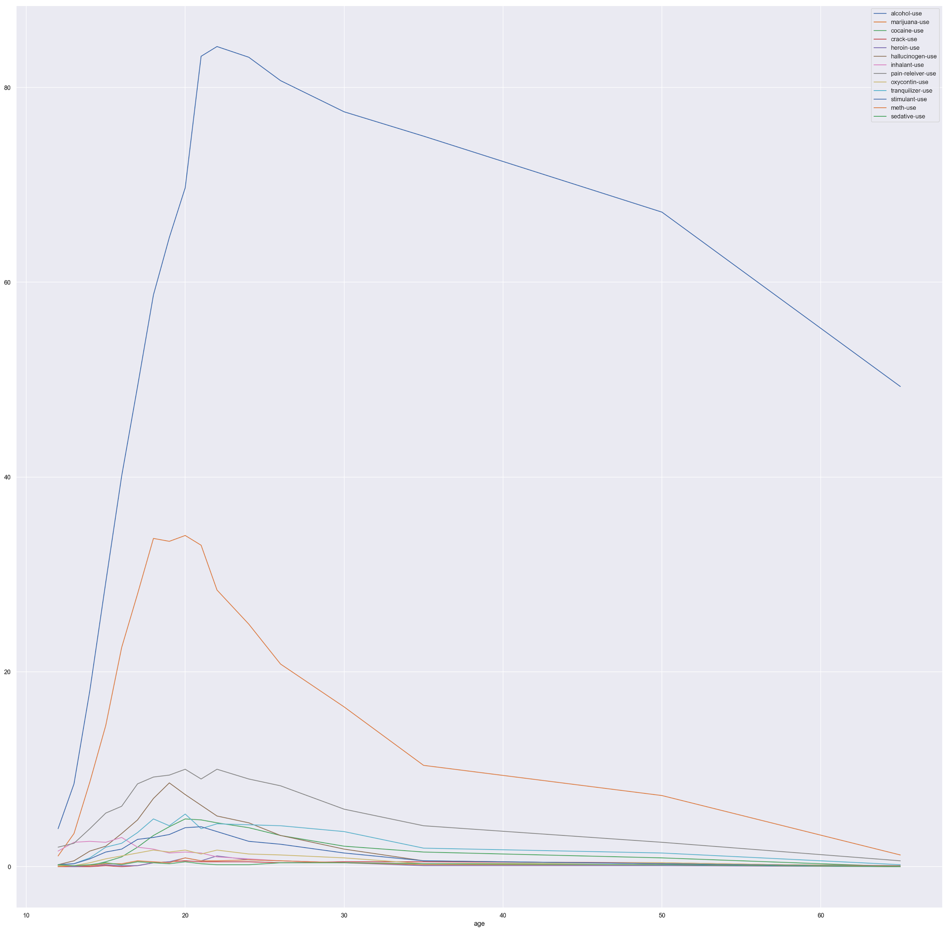
Let’s look at trends over age in drug use

Slide 15
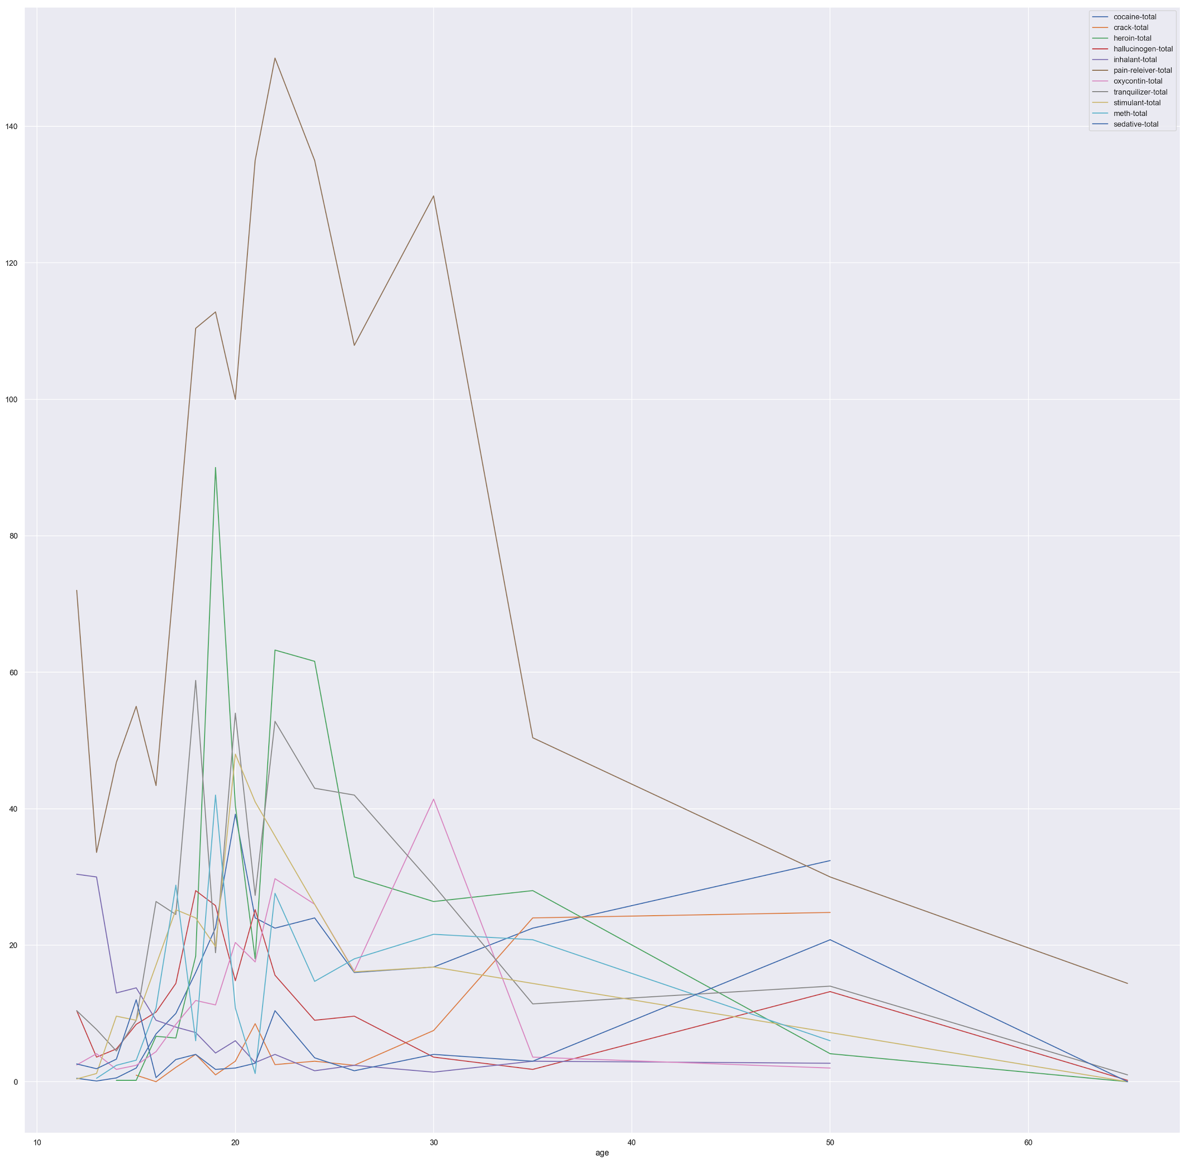
Let’s remove marijuana and alcohol from the data

Slide 16

Let’s check heat map of total drug use correlation
Total Marijuana and Alcohol still dominates

Slide 17
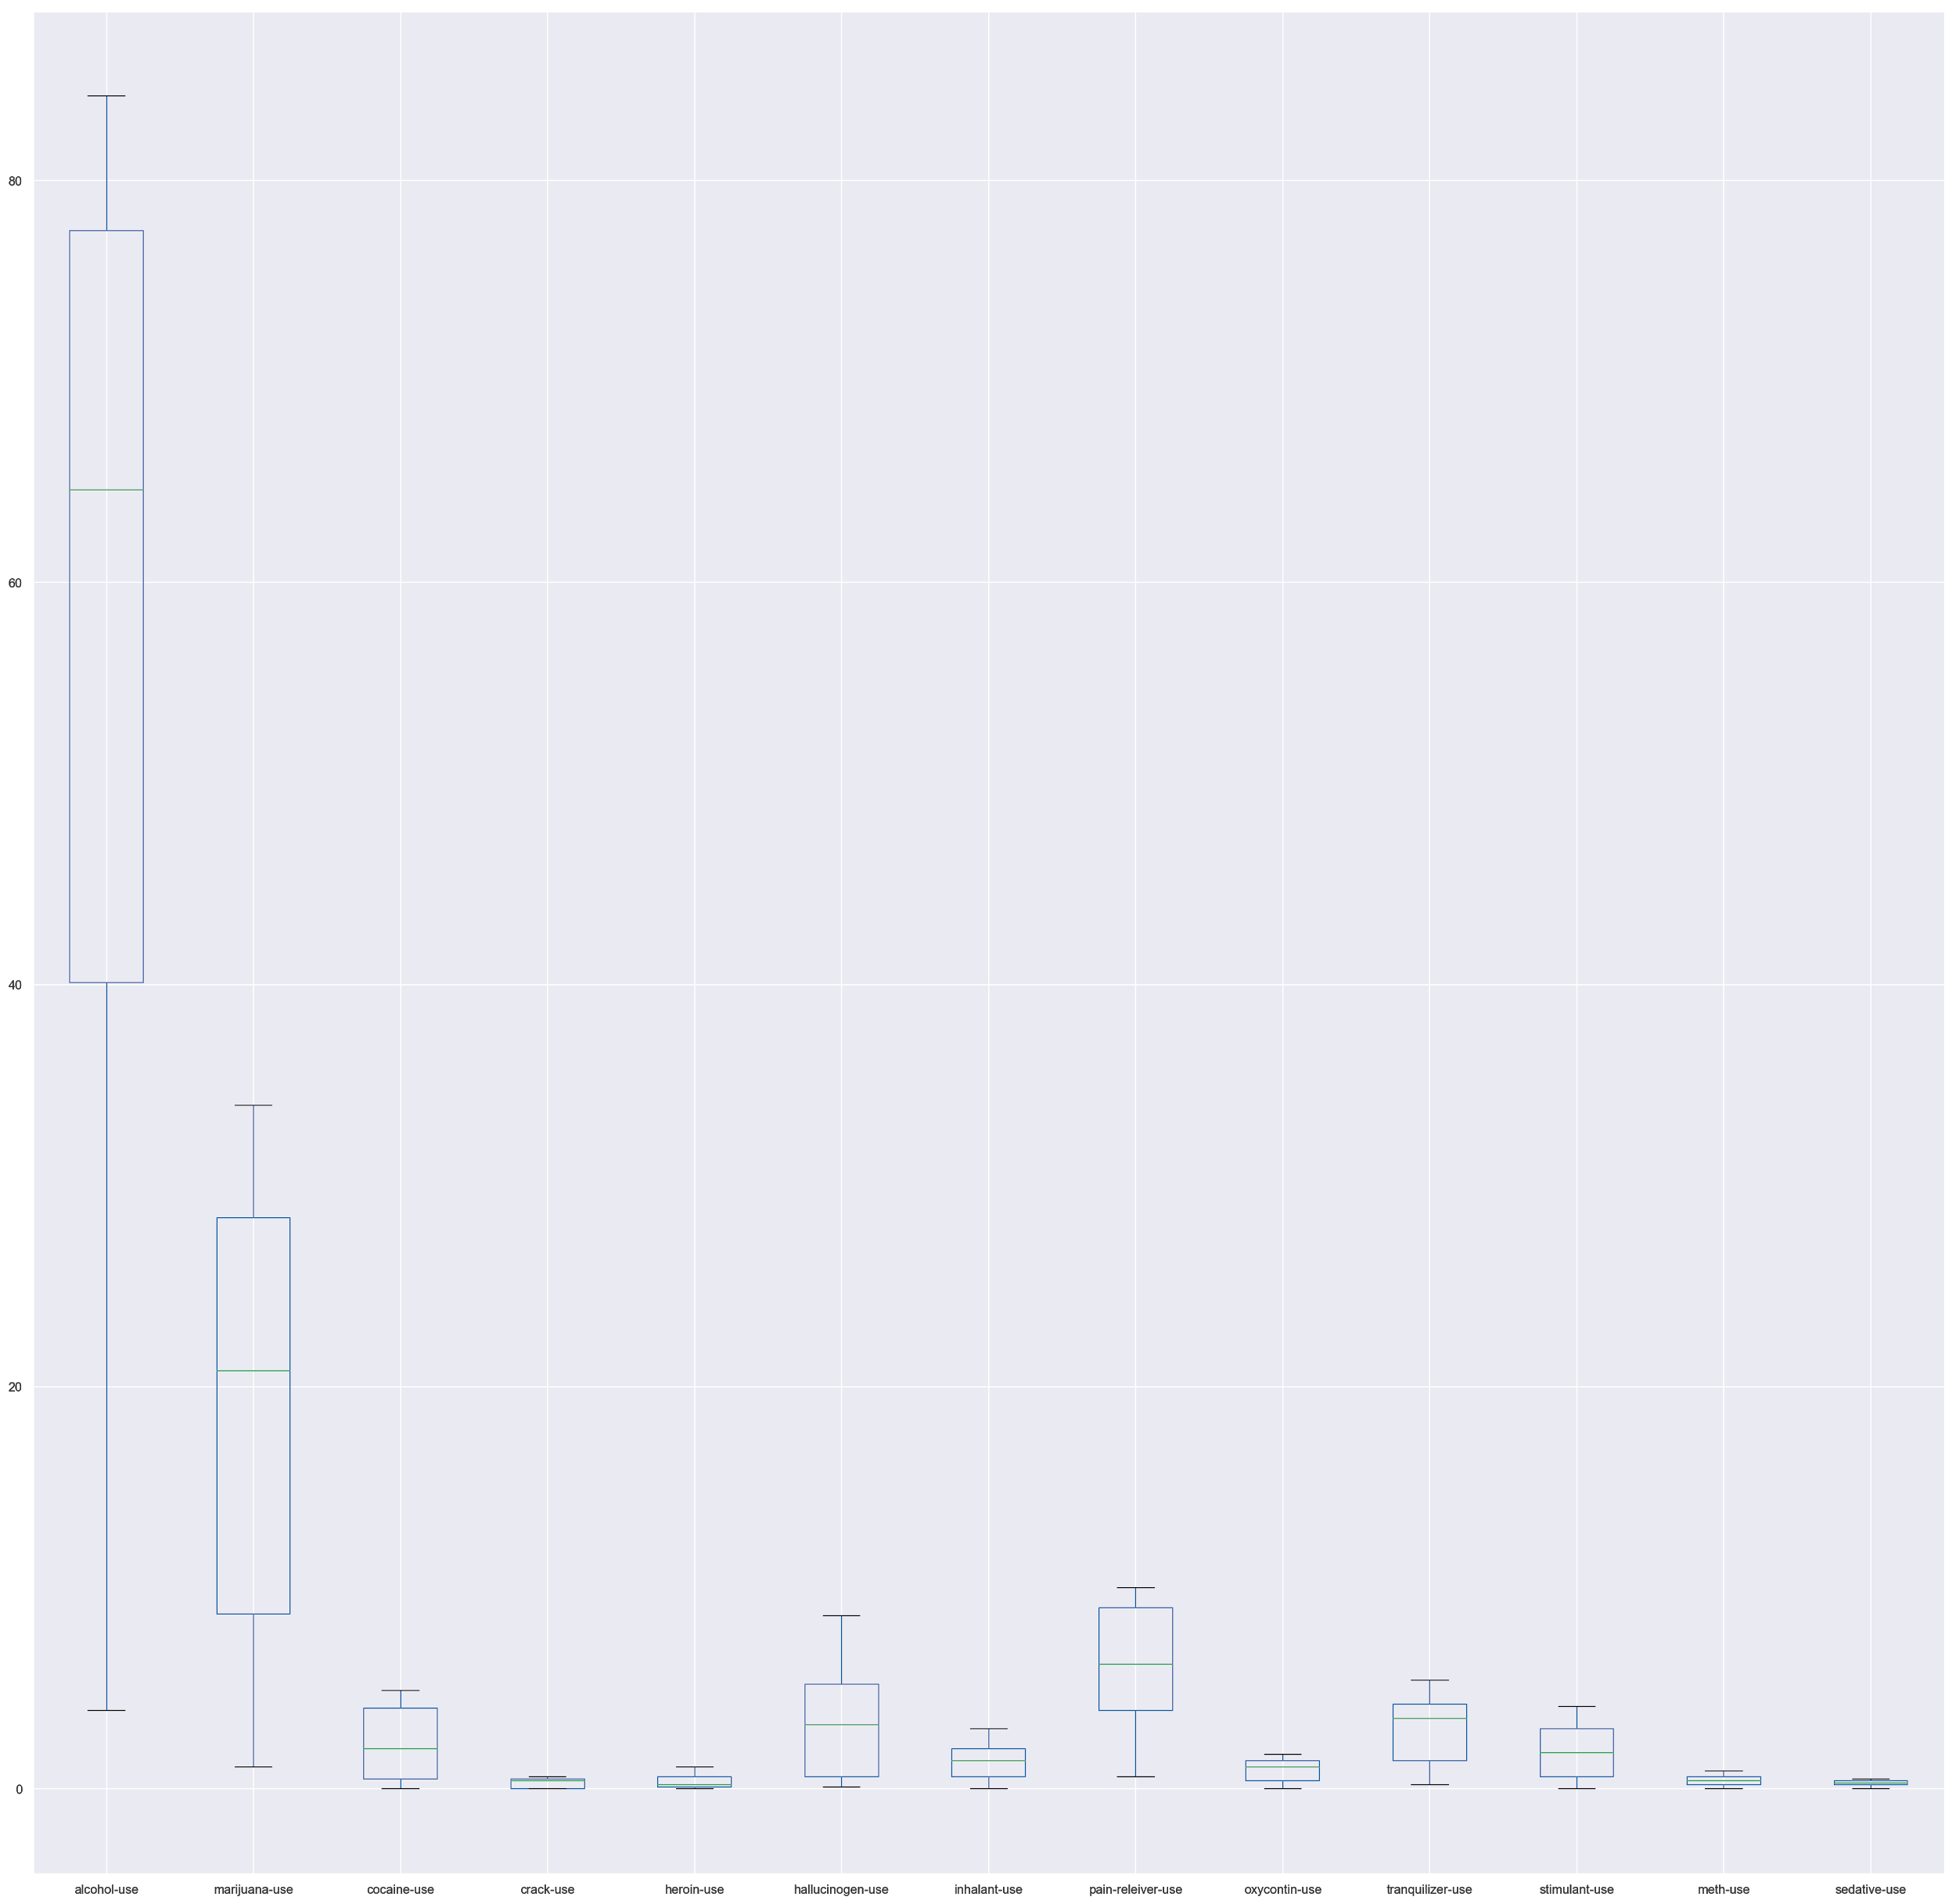
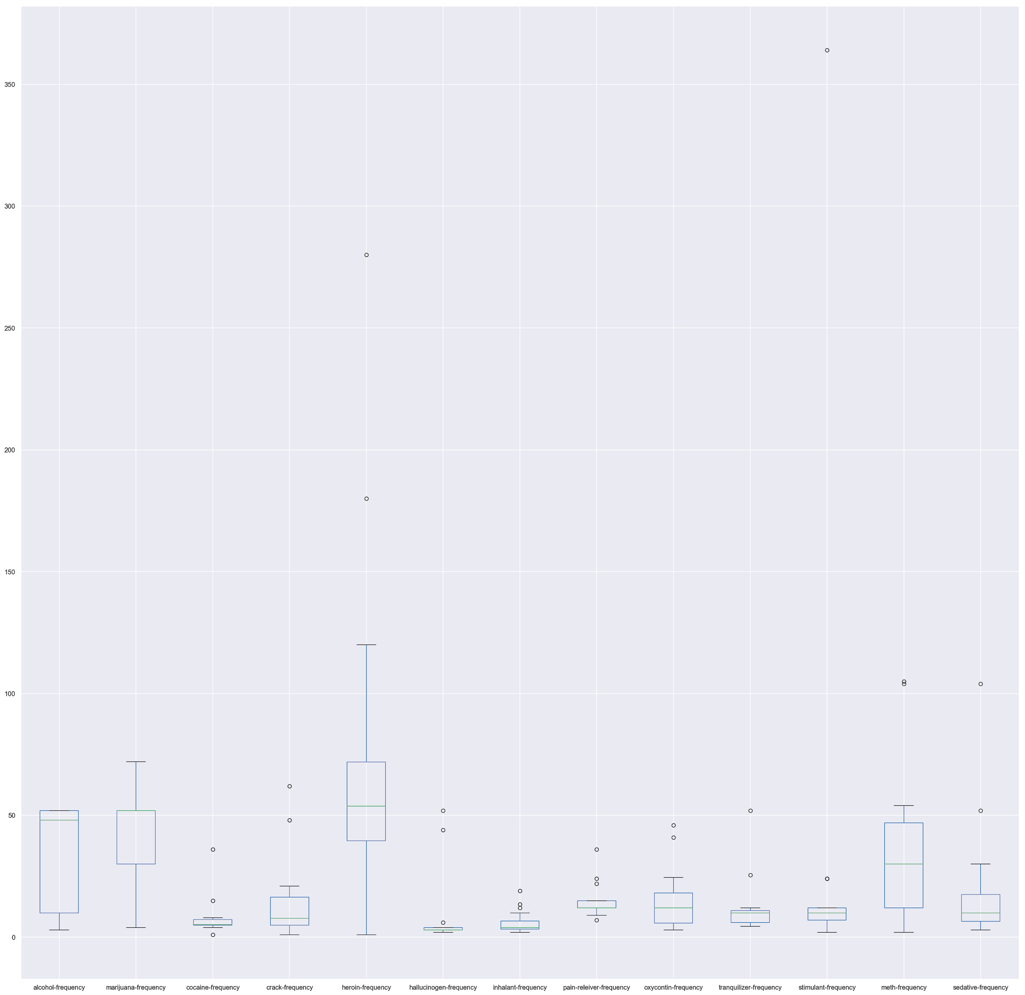
Let’s show me the numbers
Drug Usage
Drug Frequencies
High frequency of Heroin use

Slide 18
Let’s hypothesise
Abstract: The concept of “gateway hypothesis” has been studied since the 1970s (Kandel, 1975, Kandel and Faust, 1975) as the theory suggests that an adolescent's early experimentation with alcohol or tobacco or cannabis escalates to more addictive illicit drugs later in adulthood (Lynskey et al., 2003). Most commonly used illicit substances include heroin/opioids, cocaine and or amphetamines and their designer drug analogs, considered illegal by the criminal justice system in the United States and other jurisdictions. Early onset or drug experimentation has been elaborated and characterized in distinct pathways in the substance abuse and dependence literature. Overall, the theory has had mixed results showing both a link or sequence of licit drug use to illicit drug use (Guxens et al., 2007, Guxens et al., 2007, Korhoene et al., 2010, Lessem et al., 2006, Mayet et al., 2012) and no association (Mackesy-Amiti et al., 1997, Golub and Johnson, 1994). https://www.ncbi.nlm.nih.gov/pmc/articles/PMC4929049/ - Introduction.

Slide 19
Question
Is marijuana a "gateway" drug linking to hard drug usage? Usage of marijuana is later followed by an increase in other hard drugs.

Slide 20
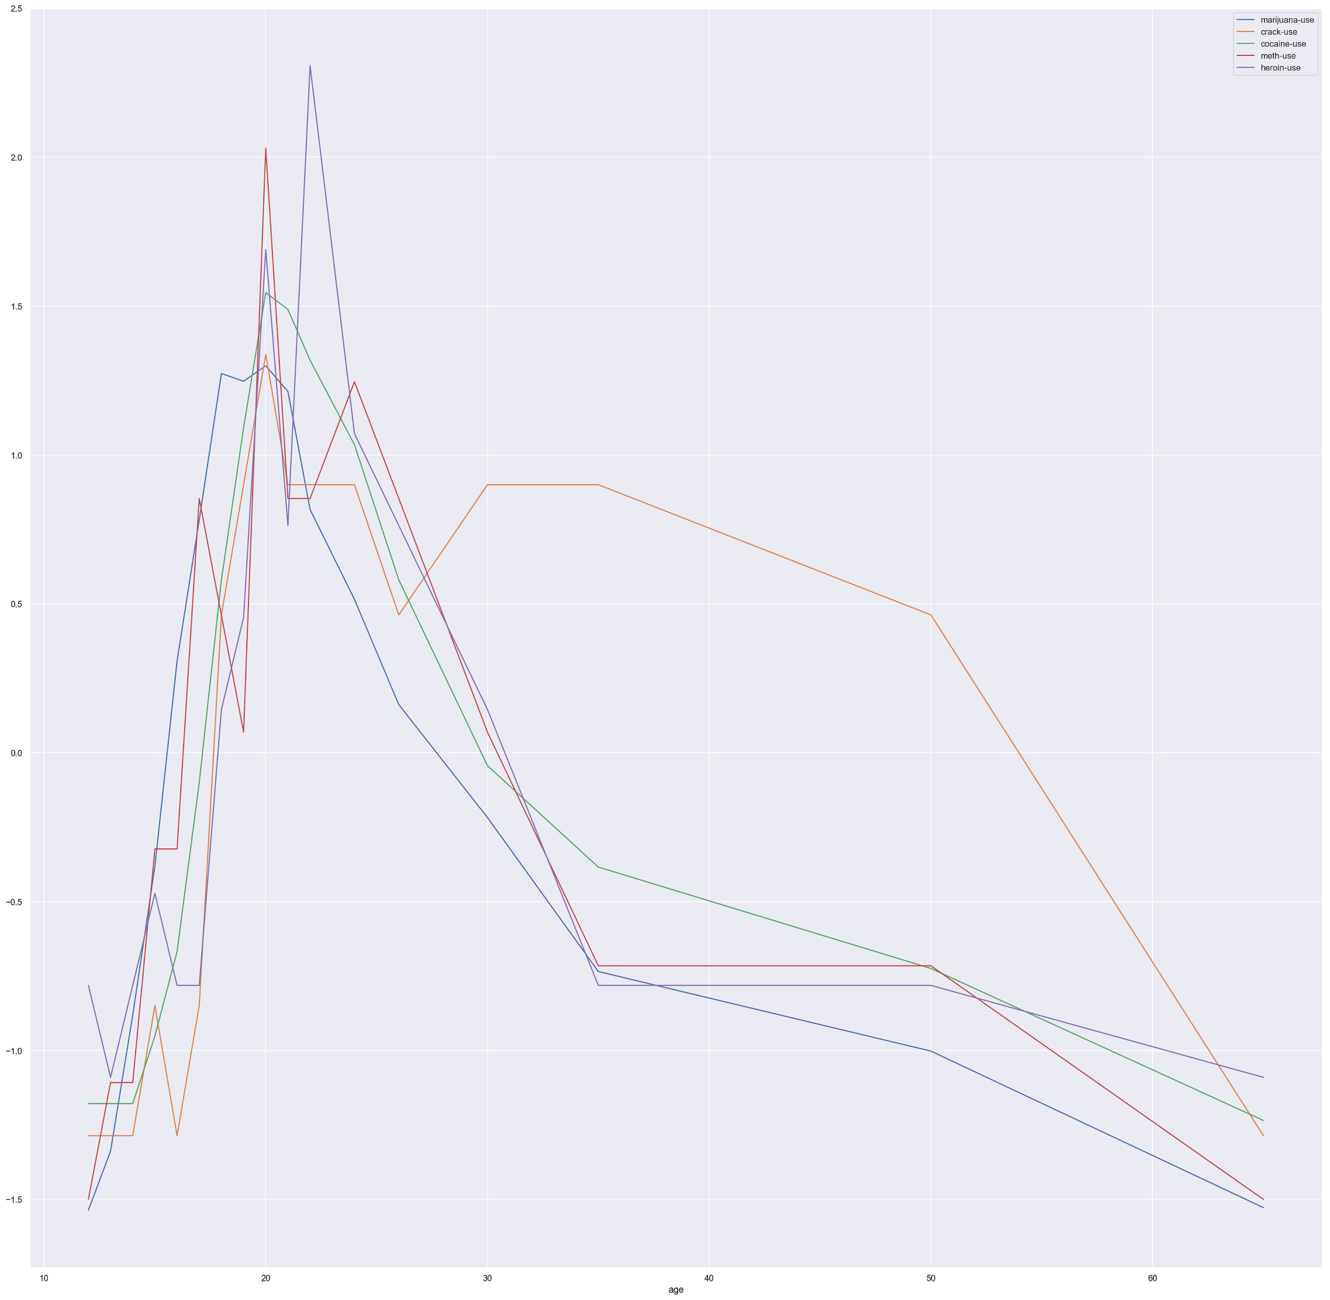
Let’s find out
Since drug usage starts at an early age, we should study the age only till 30 years old to see how people adopt drugs as they grew up, noting whether marijuana leads in acceleration

Slide 21
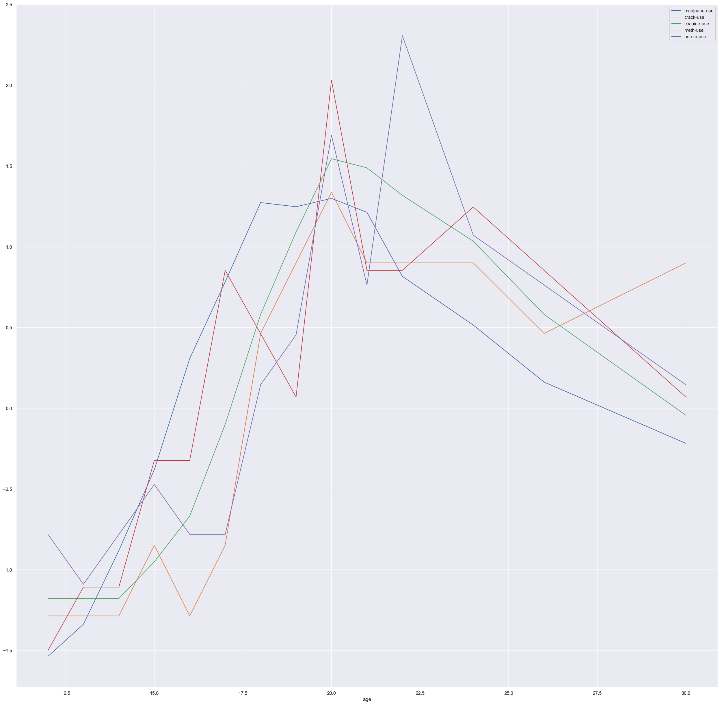
We observe that marijuana increases faster than the other drugs in the normalized graph. And when marijuana use decreases, the use of other drugs decreases after it.

Slide 22
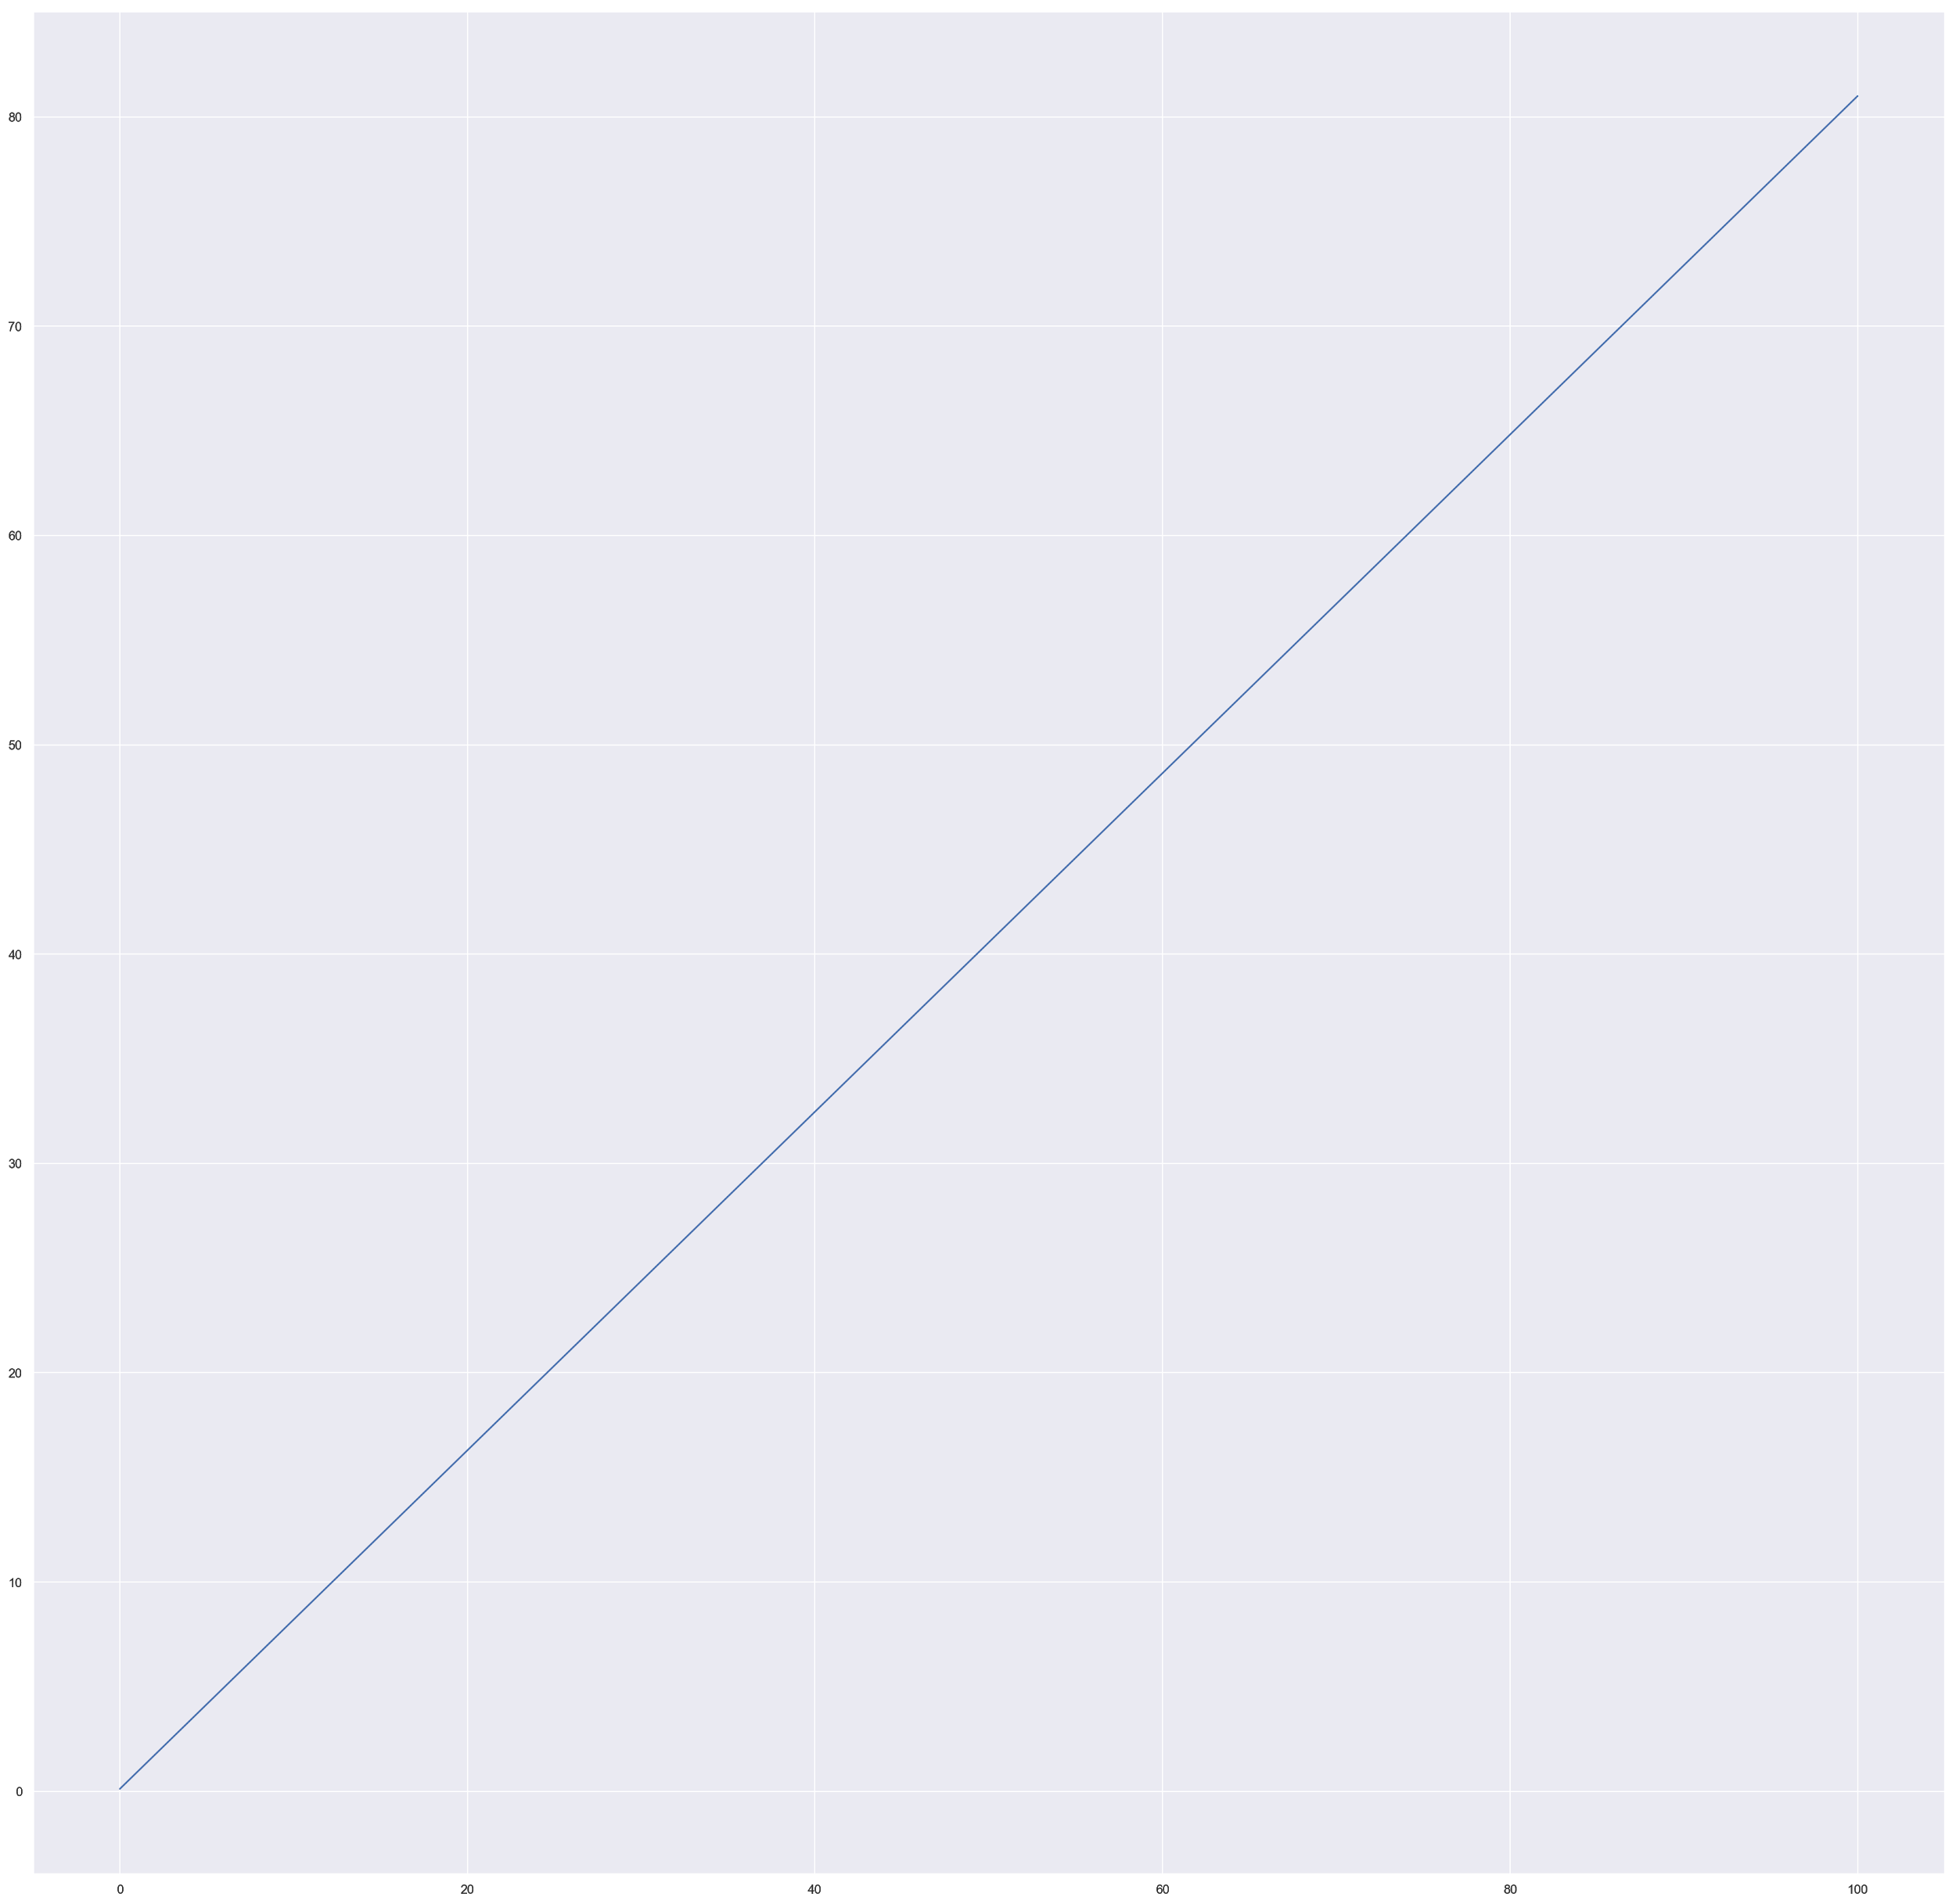
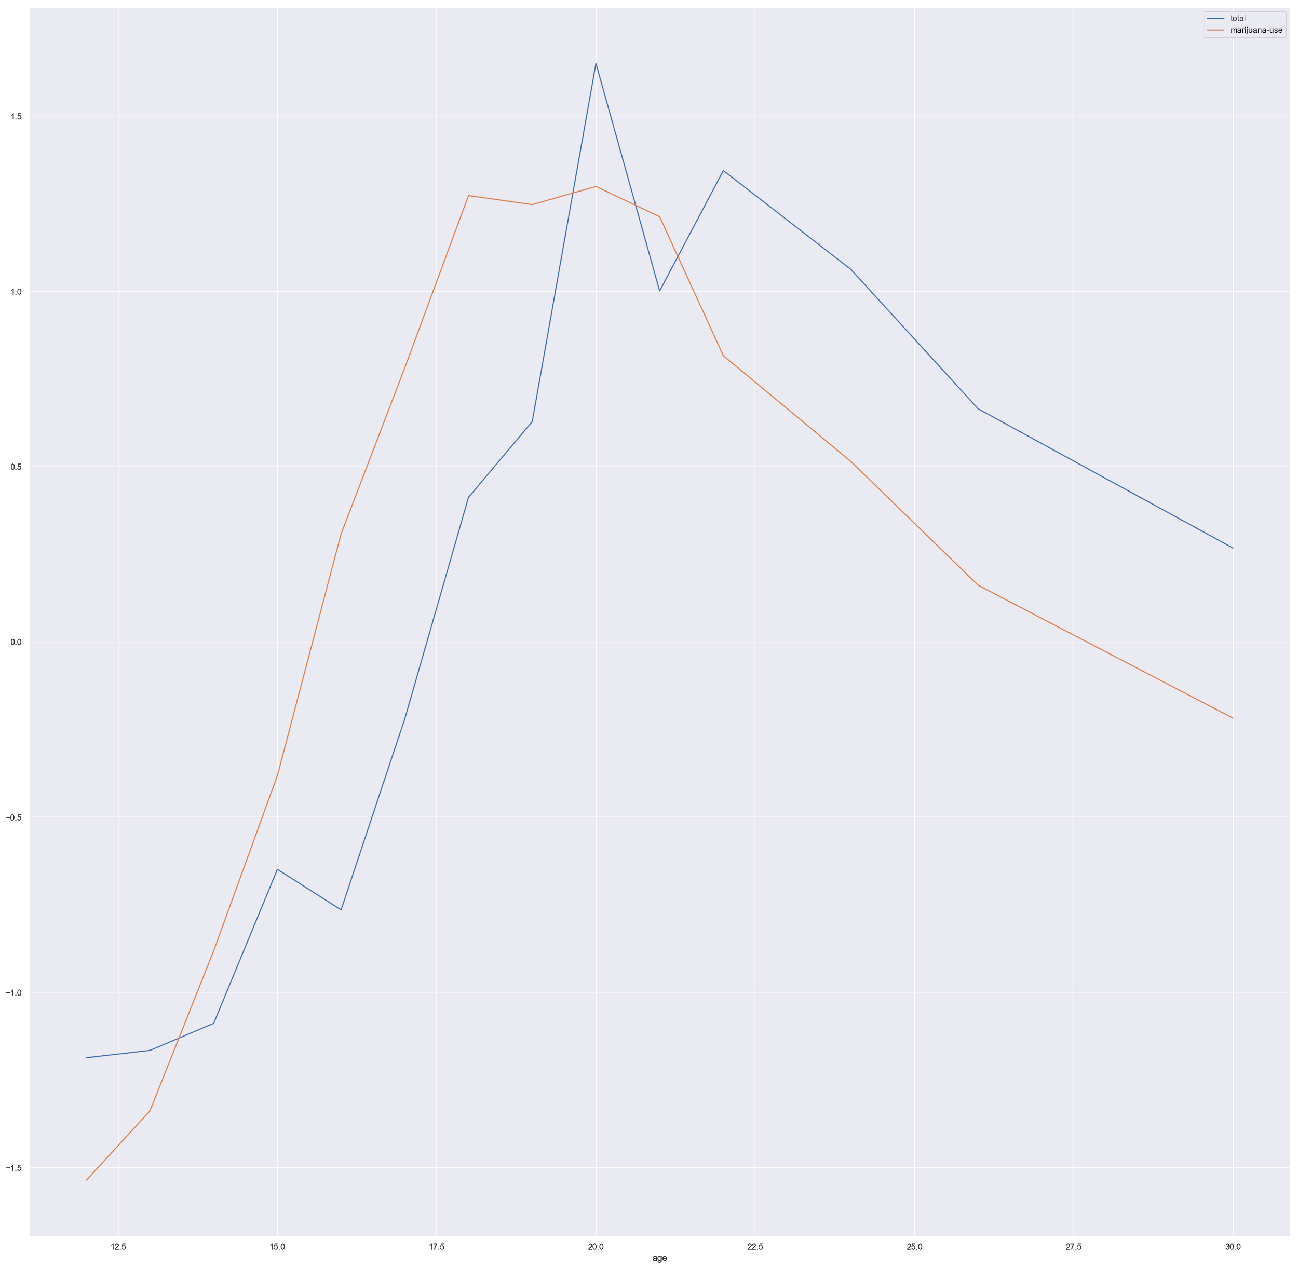
Let’s average out the total drug use against marijuana
Linear Regression line
Our hypothesis that Marijuana is a gateway to more elicit drug use is showing positively correlate was accepted view from a younger group age to 30yrs old on the study. There is a linear relationship that trends positively based on the analysis of the data.
Total Drug use Vs Marijuana

